Slide 1

Did the Russian/Ukraine War Effect Commodity Prices in the US?
Presented by: Crystal Butler, James Senger, John Quinn, and Jared Worrick

Slide 2
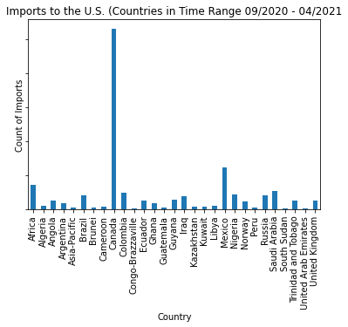
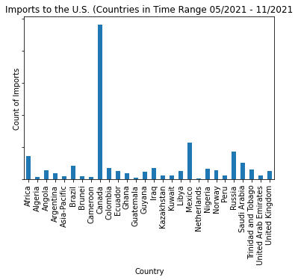
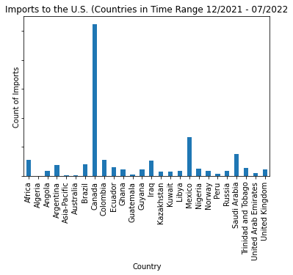
Canada is the number one importer of Crude Oil Imports to the USA while Mexico then Russia follows behind. Russia has reduced the exports to the USA in 2022 more than 75%
Bar Chart of most imported by Count of Crude Oil Barrels to USA

Slide 3
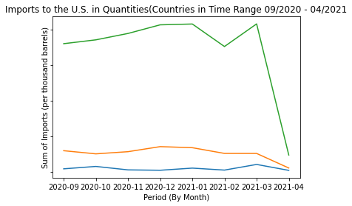
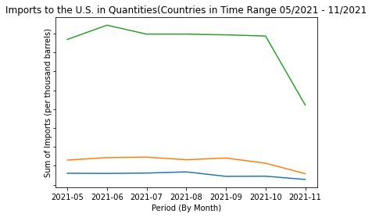
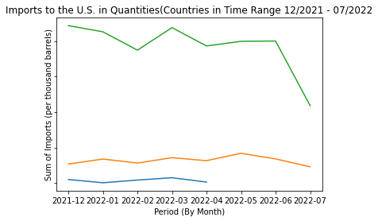
The three periods show the quantities (per thousand barrels) that Canada, Mexico, and Russia has sent to the USA for Crude Oil Imports. We can see that the USA had stopped receiving imports from Russia after April, 2022.
Crude Oil Imports from 09-2020 to 07-2022

Slide 4
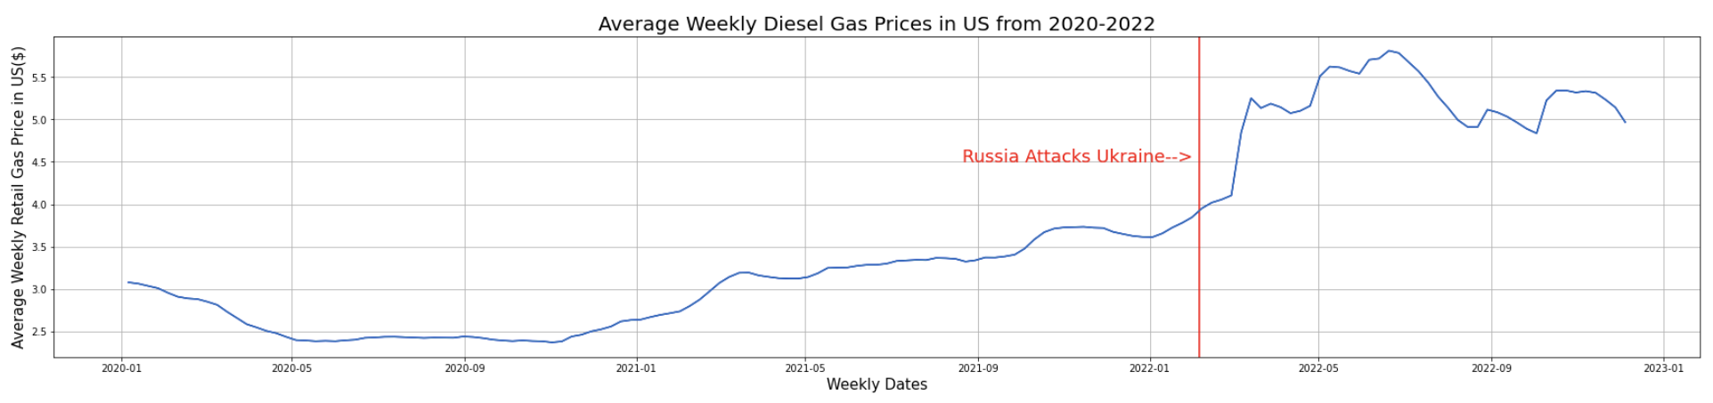
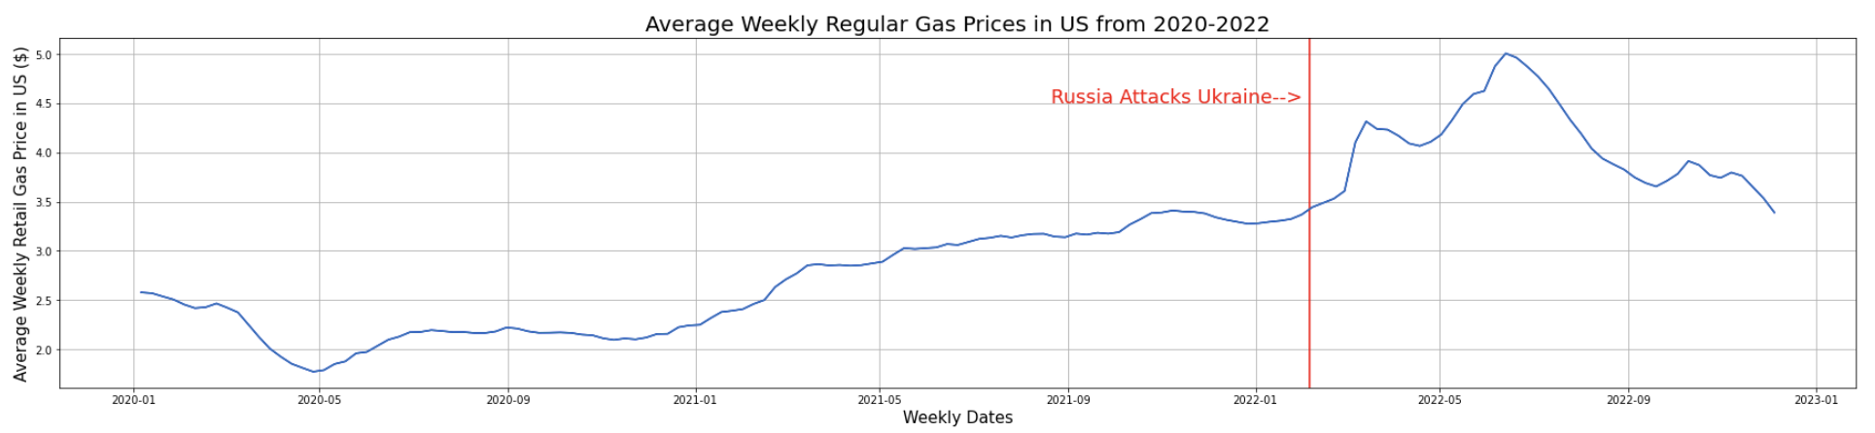
According to data pulled from EIA.gov, Diesel and Regular Gas Prices Increased at a significantly higher rate directly after Russia attacks Ukraine on February 24, 2022
By: Crystal Butler

Slide 5
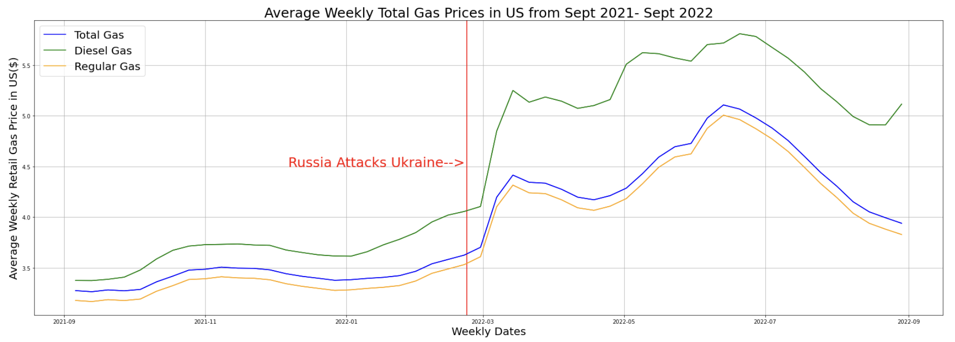
Comparing the data side by side, you can see that the Diesel gasoline was much more volatile to the start of the Ukraine War than regular gasoline. Diesel’s rate of increase was over twice the rate of Regular gasoline. Regular Gasoline increased $0.60 in two months while Diesel increased $1.40 in that same timeframe.
By: Crystal Butler

Slide 6
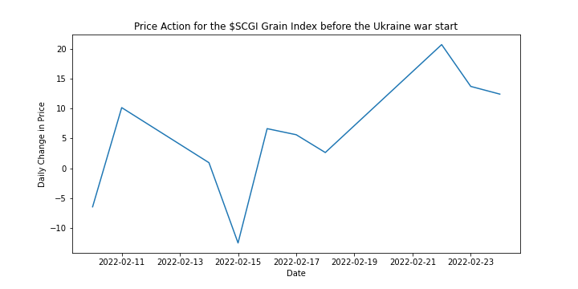
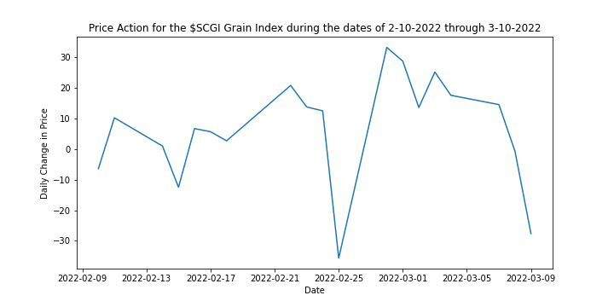
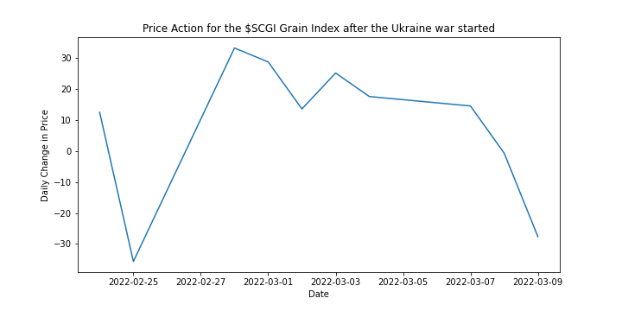
John
The month of February in the year 2022, put two of the world's largest agricultural exporters in a devastating war that is doing incalculable damage inside of Ukraine, while also damaging the commodities world market. The price action data of the 2 weeks prior and 2 weeks after the war has been collected. The chart clearly shows the volatility of the market right after the mobilization of troops on Ukraine's border and the official start of the war(The US DoD issued warnings of imminent invasion in early February to Ukraine, and the 24th when the war started.)

Slide 7
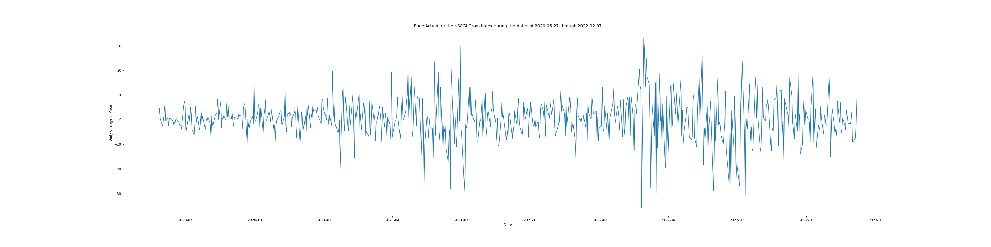
John
This is a 2-year snapshot of the SCGI Wheat index, as you can see the period after 2022-01 is extremely volatile as the Ukraine war started near the end of February.

Slide 8
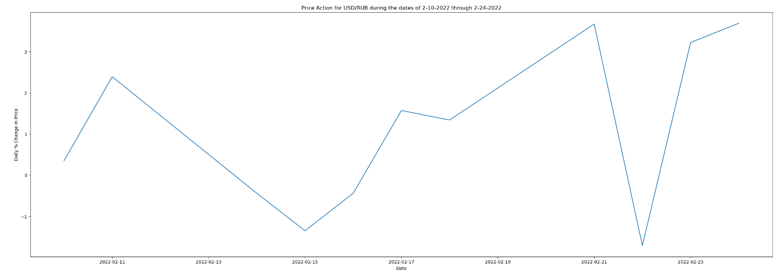
James
2 Weeks Prior to the Russian Invasion of Ukraine. Feb 10 2022 – Feb 24 2022
As you can see, right before Feb 24 2022, the USD rose over the RUB at a larger rate than seen before in the weeks before.

Slide 9
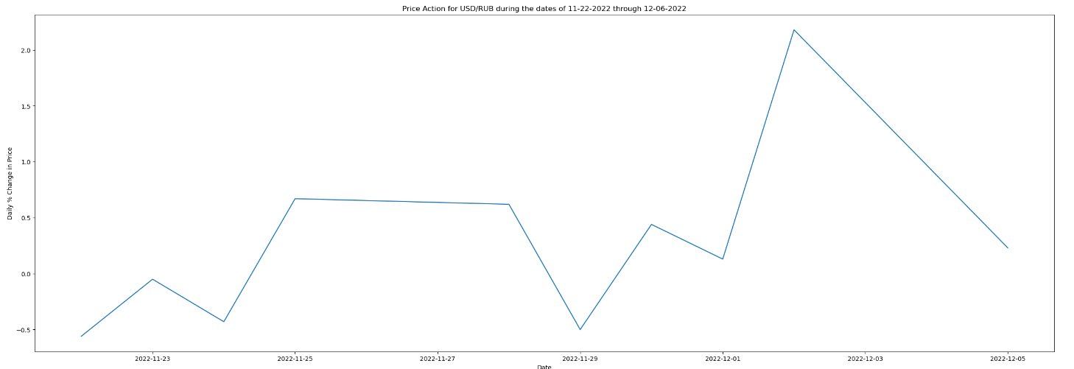
James
As shown in the chart, the USD has been steadily beating the RUB till recently. Dec. 2 is where the RUB had started to gain momentum over the USD again.

Slide 10

FINAL CONCLUSIONS
Russia’s attack on Ukraine affected many commodity prices in the US almost immediately.
Gasoline prices increased as a much higher rate than they were increasing up until that point
Grain prices were relatively steady until warnings from international bodies started to hit the market, but it has become extremely volatile ever since the Ukraine war started. We likely will not see the volatility end until the war ends and both countries resume their agricultural production from before the war.
In the 2 weeks prior to the invasion, the Russian Ruble had a bearish spike compared to the United States Dollar. It is only till recently that it has gained bullish traction.

